Slide 1
Job Mashup Website
Group 2 : Team G² : Jacob Barrick, Colin Blower, Honming Chen,
Curtis Davis, Victor Frandsen, Sam Lanzo, Andrew Miller, Yu-Ching Wang

Slide 2
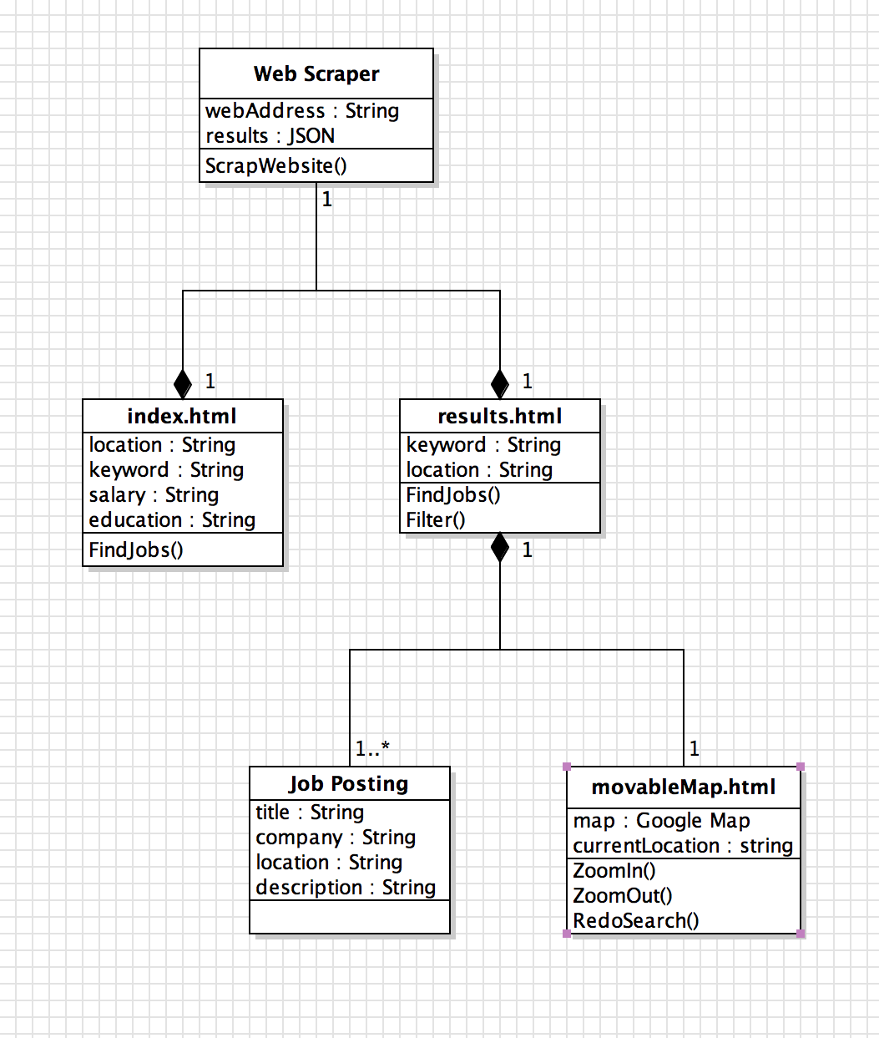
UML
Violet UML Editor

Slide 3


Languages
Google API
HTML

Slide 4



JSON

Slide 5


Editors & Tools

Slide 6



Editors & Tools

Slide 7
Demo Time
Demo
Demo
Demo

